Slide 1
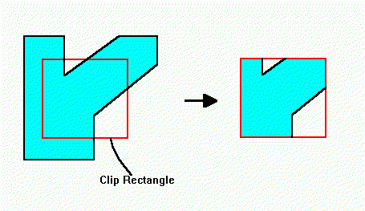
Lecture 6
Viewing & Clipping

Slide 2
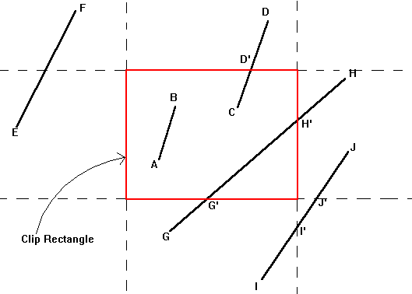
Cohen-Sutherland Clipping Algorithm

Slide 3
Clipping terminologies
Window : the whole picture is known as window before cropping/clipping
Viewport : the clipping/cropping frame is known as viewport
Visible lines: The points/lines/entities lies within the viewport hence no clipping needed
Invisible lines: The points/lines/entities lies outside the viewport hence no clipping needed
Intersected lines: The points/lines/entities lies on the viewport hence definitely clipping is needed.

Slide 4
Cohen-Sutherland Clipping Algorithm for intersecting lines
For left window edge, intersection point will be (x_{L},y)
y=m(x_{L}-x₁)+y₁, m not equal to infinity
For right window edge, intersection point will be (x_{R},y)
y=m(x_{R}-x₁)+y₁, m not equal to infinity
For top window edge, intersection point will be (x,y_{T})
x=x₁+(1/m)(y_{T}-y₁), m not equal to zero
For bottom window edge, intersection point will be (x,y_{B})
x=x₁+(1/m)(y_{B}-y₁), m not equal to zero

Slide 5
In the above equations:
xL is the x value of the left edge of clipping window
xR is the x value of the right edge of the clipping window
yB is the y value of the bottom edge of clipping window
yT is the y value of the top edge of the clipping window
Acceptable values of x and y are x_{L <= x <=} x_{R and}
y_{B <= y < =} y_{T}

